Slide 1
Wind Energy: Wind Energy Conversion, Potential, Wind Energy Potential Measurement, Site Selection
SlideMake.com

Slide 2
Introduction
Wind energy is the conversion of wind into useful forms of energy.
It is a renewable and clean source of power.
Wind turbines are used to convert wind energy into electricity.
Notes:
Image source: https://www.treehugger.com/what-is-wind-energy-5097217

Slide 3
Wind Energy Conversion
Wind turbines are the most common method of converting wind energy.
The kinetic energy of the wind is converted into mechanical energy by the turbine blades.
The mechanical energy is then converted into electrical energy by a generator.
Notes:
Image source: https://www.researchgate.net/figure/Components-in-a-wind-energy-conversion-systems-26-Components-in-a-wind-energy_fig2_348045157

Slide 4
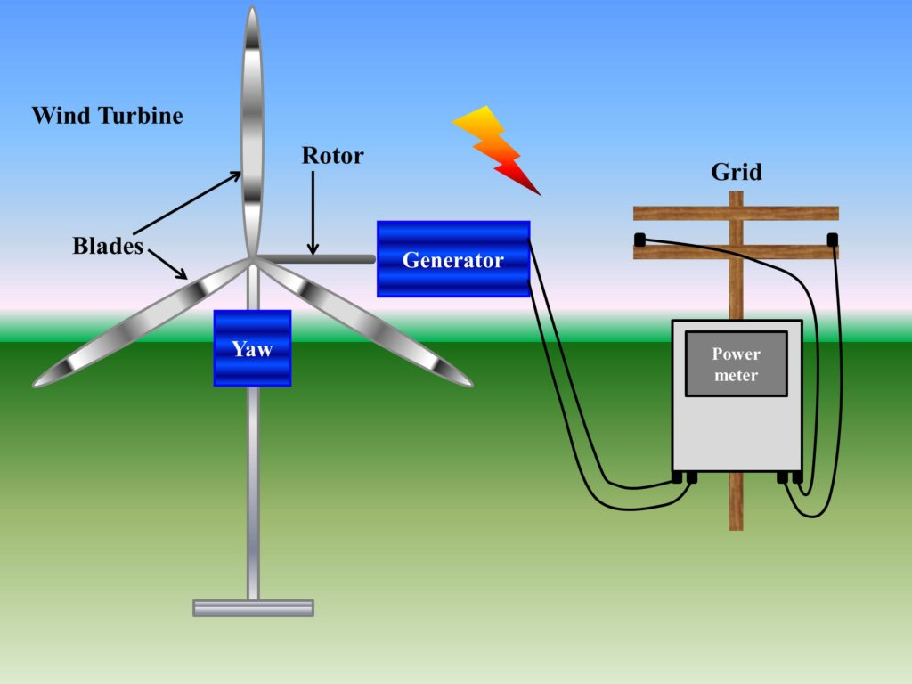
Wind Energy Potential
The potential for wind energy varies based on geographical location.
Factors such as wind speed, direction, and stability determine the potential.
Areas with consistent and strong winds have higher energy potential.
Notes:
Image source: https://www.asrmeta.com/wind-energy-from-wind-turbine-components-and-efficiency/

Slide 5
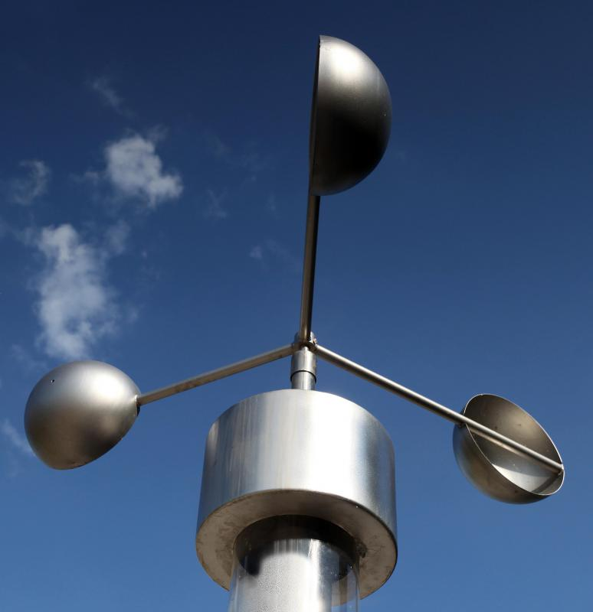
Wind Energy Potential Measurement
Anemometers are used to measure wind speed, which is a key factor in determining wind energy potential.
Wind vanes are used to measure wind direction.
Data collected by these instruments is used to analyze wind energy potential.
Notes:
Image source: https://www.wisegeek.com/what-are-the-different-techniques-for-wind-speed-measurement.htm

Slide 6
Site Selection
Site selection is crucial for maximizing wind energy potential.
Areas with high average wind speeds are preferred for wind farm installations.
Topographical features, such as hills and valleys, can affect wind flow and should be considered during site selection.
Notes:
Image source: https://www.researchgate.net/figure/Wind-farm-selection-criteria_fig4_341464098

Slide 7
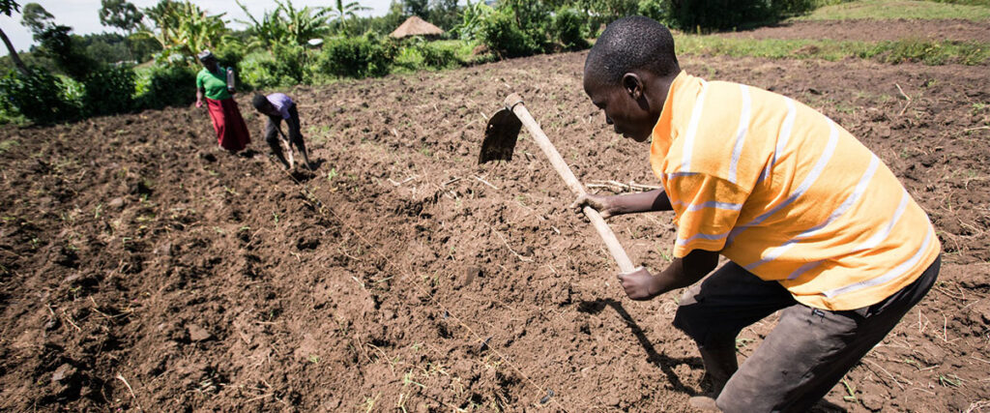
Site Selection - Land Availability
Sufficient land availability is necessary for wind farm installations.
Large open spaces, such as agricultural or rural areas, are often suitable for wind farms.
Land ownership and leasing agreements are important considerations during site selection.
Notes:
Image source: https://naads.or.ug/site-selection-and-land-preparation/

Slide 8
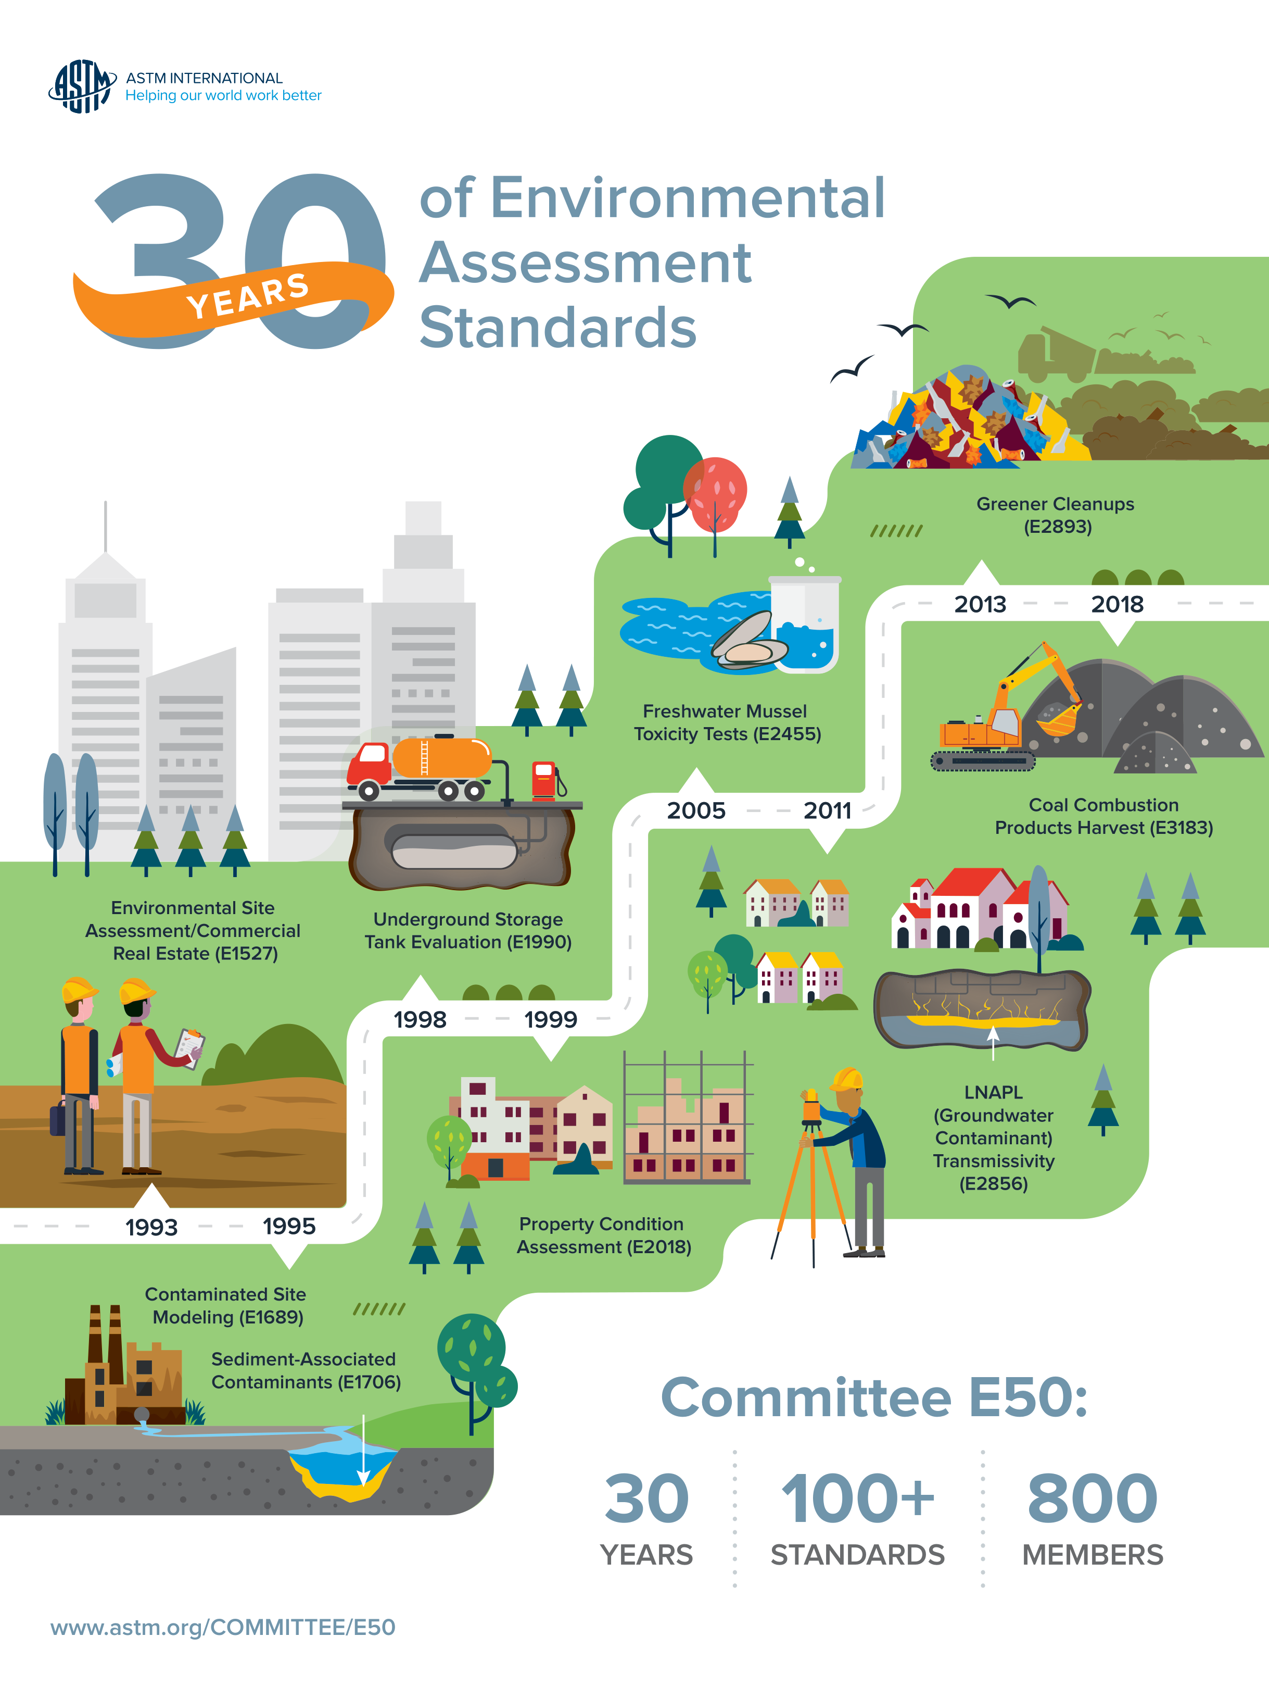
Site Selection - Environmental Impact
Environmental impact assessments are conducted to evaluate potential effects on wildlife, habitats, and ecosystems.
Sensitive areas, such as migratory bird routes or protected habitats, should be avoided.
Mitigation measures, such as proper turbine placement and design, can minimize environmental impacts.
Notes:
Image source: https://www.pinterest.com/pin/218283913177849763/

Slide 9
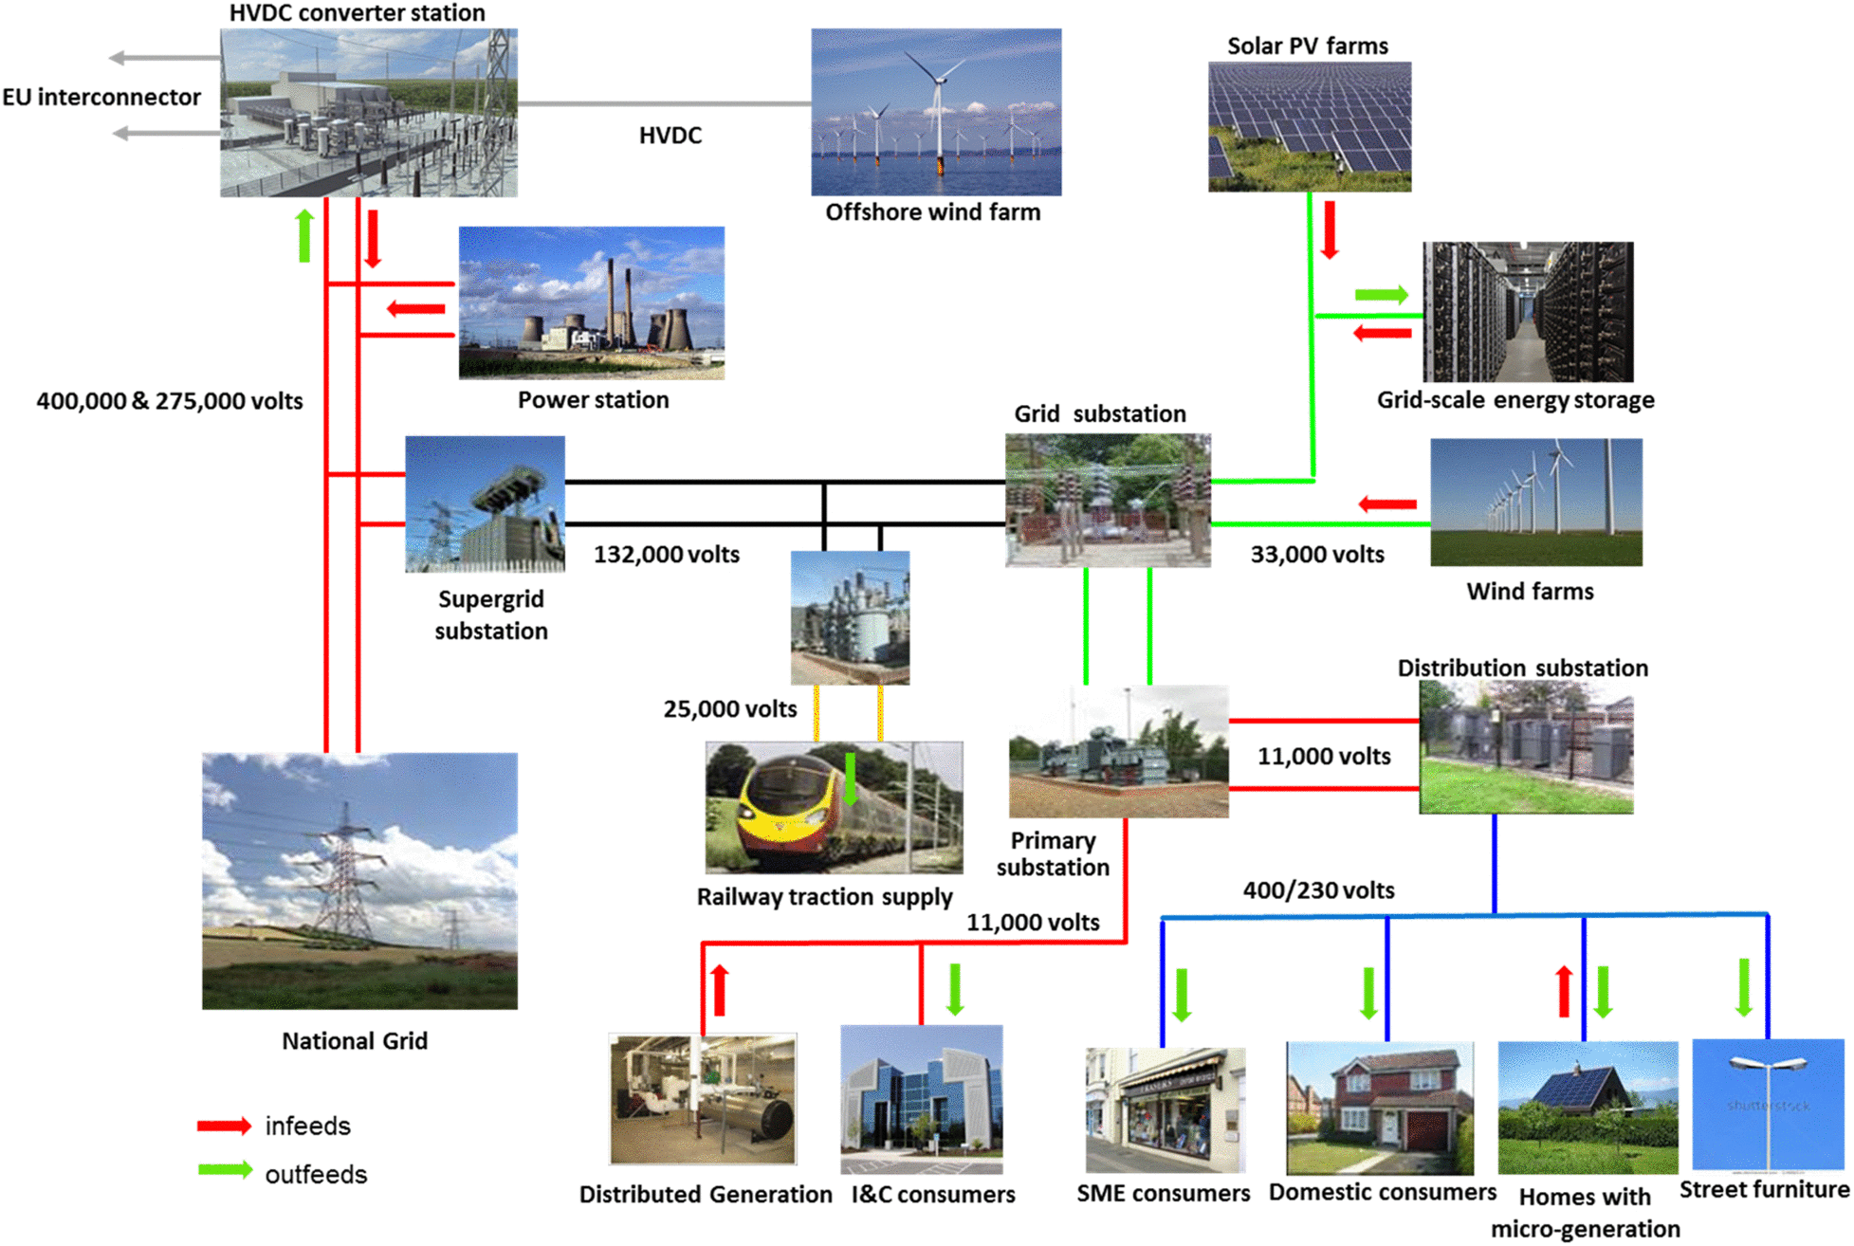
Site Selection - Grid Connection
Proximity to existing electrical infrastructure is important for connecting wind farms to the grid.
Transmission lines and substations need to be in place or planned for efficient power distribution.
Grid connection costs and feasibility should be considered during site selection.
Notes:
Image source: https://www.kbic-nsn.gov/lv-distribution-network-planning-and-design/

Slide 10
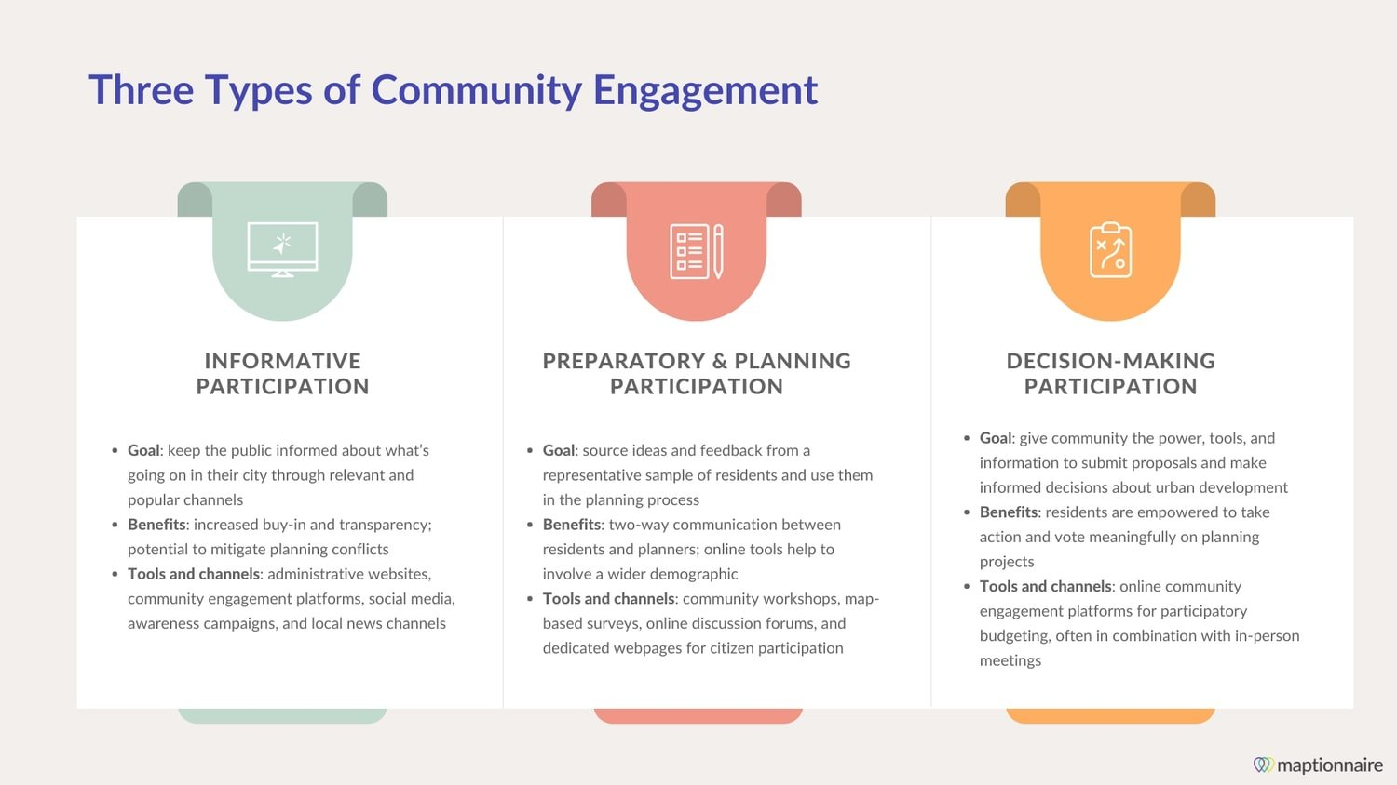
Site Selection - Community Engagement
Engaging with local communities is crucial for successful wind energy projects.
Public consultation and involvement help address concerns and gain support.
Community benefits, such as job creation and revenue sharing, can enhance acceptance of wind projects.
Notes:
Image source: https://maptionnaire.com/blog-list/types-of-community-engagement-in-urban-planning

Slide 11
Site Selection - Regulatory Framework
Understanding and complying with local, regional, and national regulations is essential.
Permits, licenses, and environmental impact assessments may be required.
Planning authorities and regulatory bodies should be consulted during site selection.
Notes:
Image source: https://nuclearsafety.gc.ca/eng/acts-and-regulations/regulatory-framework/index.cfm?pedisable=true

Slide 12
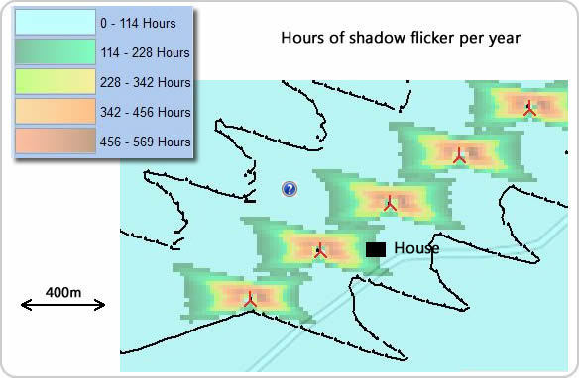
Site Selection - Noise and Shadow Flicker
Noise and shadow flicker from wind turbines can impact nearby residents.
Minimum setback distances should be considered to mitigate noise and shadow flicker effects.
Noise studies and shadow flicker modeling help evaluate potential impacts during site selection.
Notes:
Image source: https://www.greenrhinoenergy.com/renewable/wind/wind_flicker.php

Slide 13
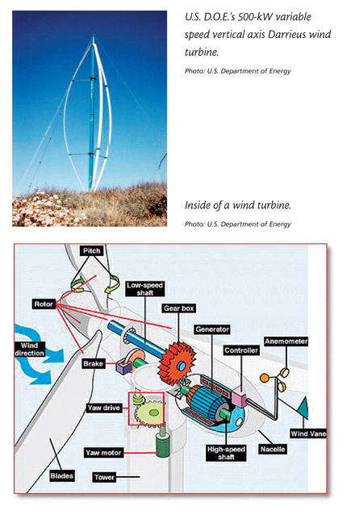
Site Selection - Wind Turbine Accessibility
Accessibility for wind turbine transportation and maintenance is important during site selection.
Road networks and suitable terrain for crane access should be considered.
Existing infrastructure, such as ports or rail lines, can facilitate turbine transportation.
Notes:
Image source: https://www.windustry.org/community_wind_toolbox_15_turbine_selection_and_purchase

Slide 14
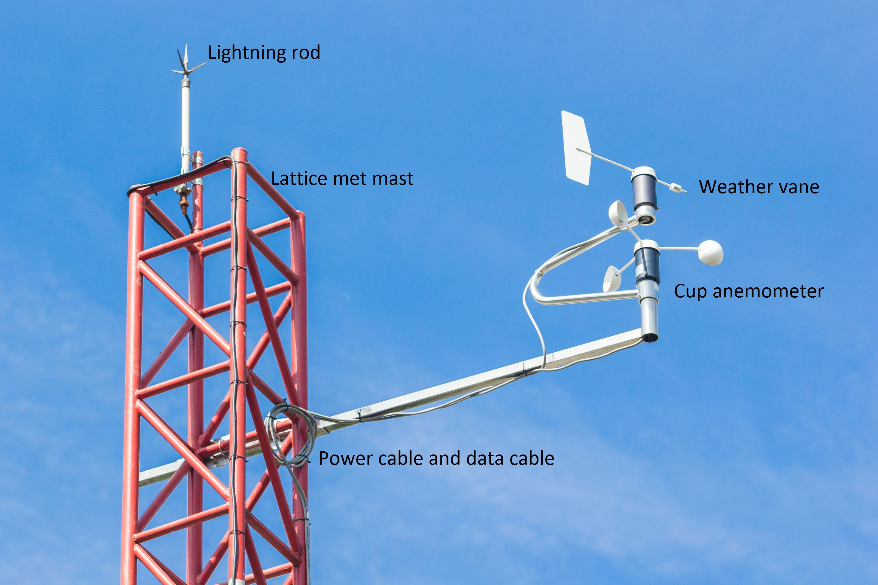
Site Selection - Wind Resource Assessment
Detailed wind resource assessments are conducted to determine the long-term wind potential.
Data from meteorological masts, remote sensing devices, and wind models are analyzed.
Wind rose diagrams and wind speed frequency distributions are used to assess wind characteristics.
Notes:
Image source: https://www.windfarmbop.com/how-to-measure-wind-resource/

Slide 15
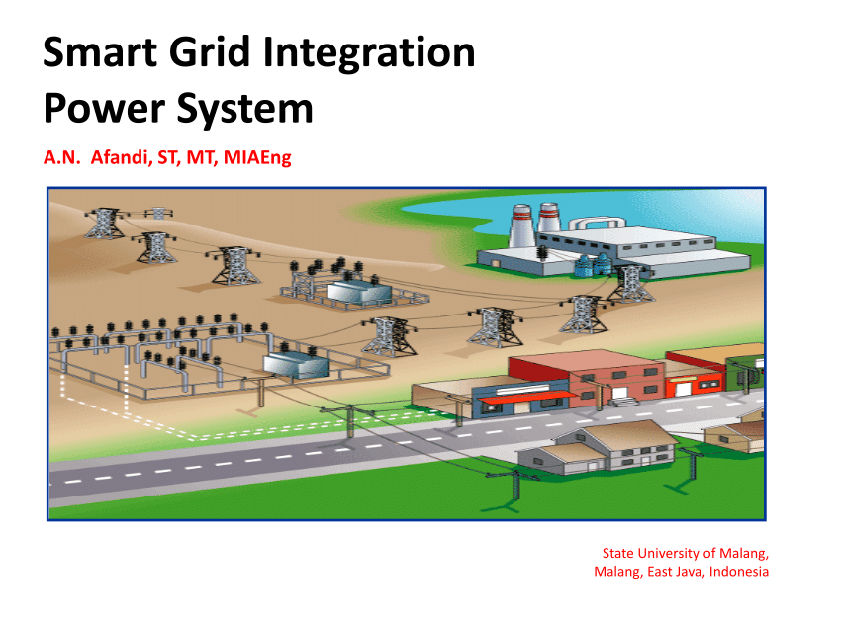
Site Selection - Grid Integration
Grid integration studies evaluate the impact of connecting wind farms to the electrical grid.
Grid stability, capacity, and power quality considerations are assessed.
Upgrades or reinforcements to the grid may be required for efficient integration.
Notes:
Image source: https://www.researchgate.net/publication/261878061_Smart_Grid_Integration_Power_System

Slide 16

Site Selection - Economic Viability
Economic viability assessments consider factors such as turbine costs, installation expenses, and maintenance.
Financial incentives, such as feed-in tariffs or tax credits, can enhance economic viability.
Long-term power purchase agreements ensure a stable revenue stream for wind energy projects.
Notes:
Image source: https://www.kmsindia.in/economic-feasibility-studies-services-in-ahmedabad/

Slide 17
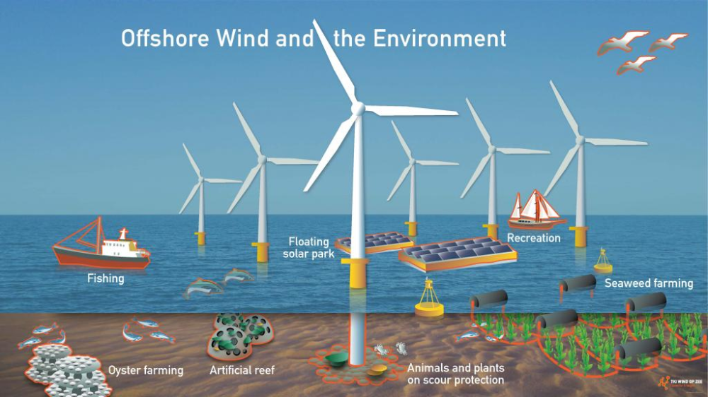
Site Selection - Offshore Wind Potential
Offshore wind potential is often higher due to stronger and more consistent winds.
Offshore wind farms can be located near coastal areas or in deeper waters using floating platforms.
Site-specific conditions, such as seabed stability and marine life considerations, are important for offshore site selection.
Notes:
Image source: https://www.pinterest.de/pin/241505598756360823/

Slide 18
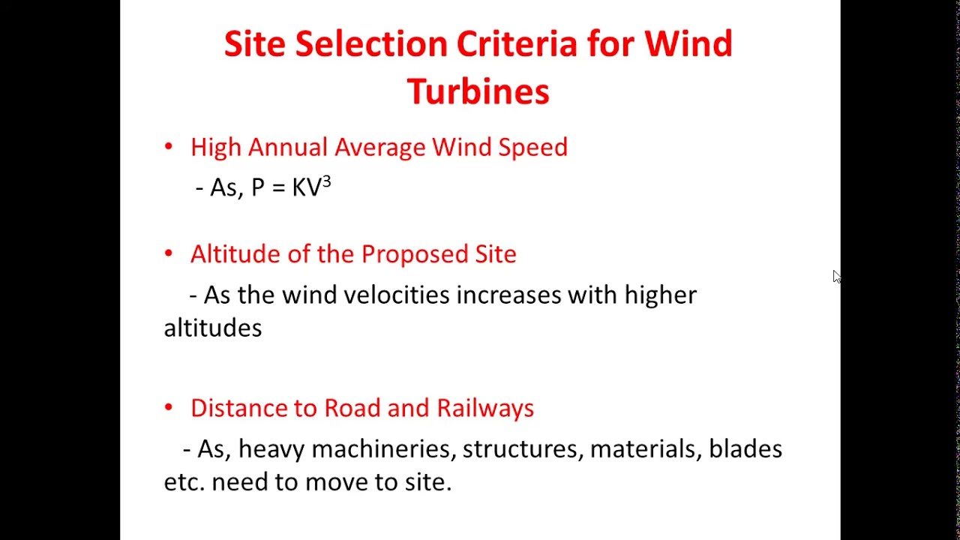
Site Selection - Micrositing
Micrositing involves optimizing the placement of individual wind turbines within a wind farm.
Factors such as wake effects, wind shear, and turbulence are considered.
Micrositing aims to maximize energy production and minimize interference between turbines.
Notes:
Image source: https://www.youtube.com/watch?v=NNBFpkNrhbY

Slide 19
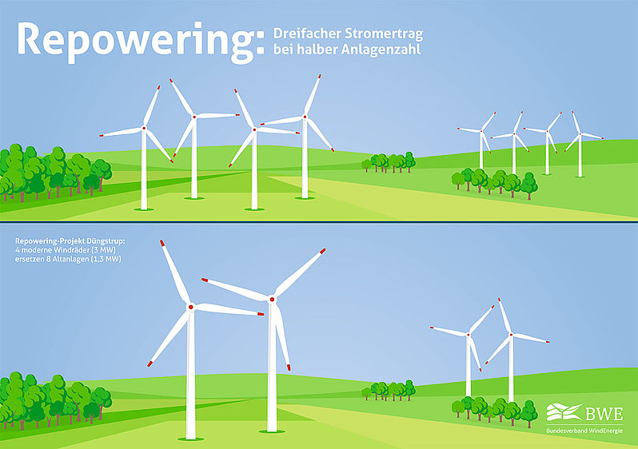
Site Selection - Repowering
Repowering involves replacing older wind turbines with newer, more efficient models.
Existing wind farm sites with suitable wind resources are considered for repowering.
Repowering can increase energy production and extend the operational life of a wind farm.
Notes:
Image source: https://www.wind-energie.de/themen/politische-arbeit/weiterbetrieb-und-repowering/

Slide 20
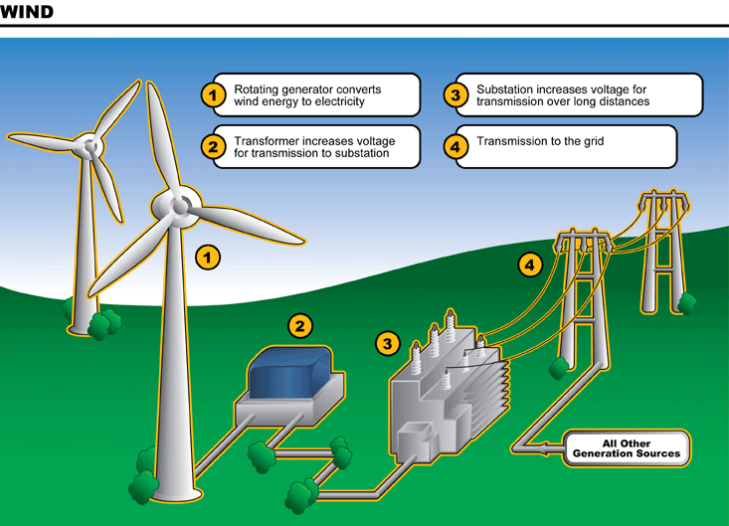
Conclusion
Wind energy offers a renewable and sustainable solution for power generation.
Proper site selection is critical for maximizing wind energy potential.
Consideration of various factors, including wind resource, environmental impact, and community engagement, ensures successful wind energy projects.
Notes:
Image source: http://bukunit.wordpress.com/science-components/wind-power/wind-energy-diagram/

